Slide 1
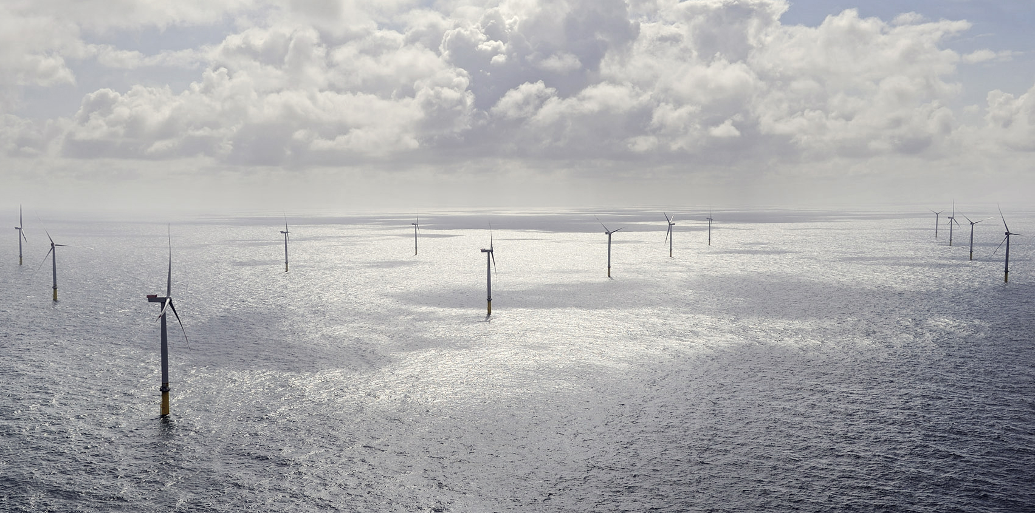
Measurements of the wind turbine induction zone
21th meeting of the Power Curve Working Group
Frederik Ettrup Brink and Nicolai Gayle Nygaard
13 December 2016, Glasgow, Scotland

Slide 2
Introduction
8 offshore wind farms in Northern Europe
Traditional power curve verifications show close match to manufacturers power curve
Induction zone measured with nacelle based lidar
Very low turbulence

Slide 3
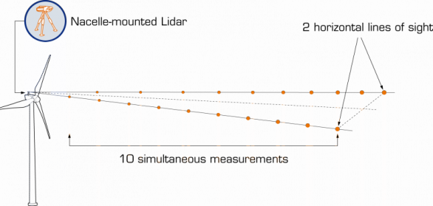
Wind Iris measurement setup

Slide 4
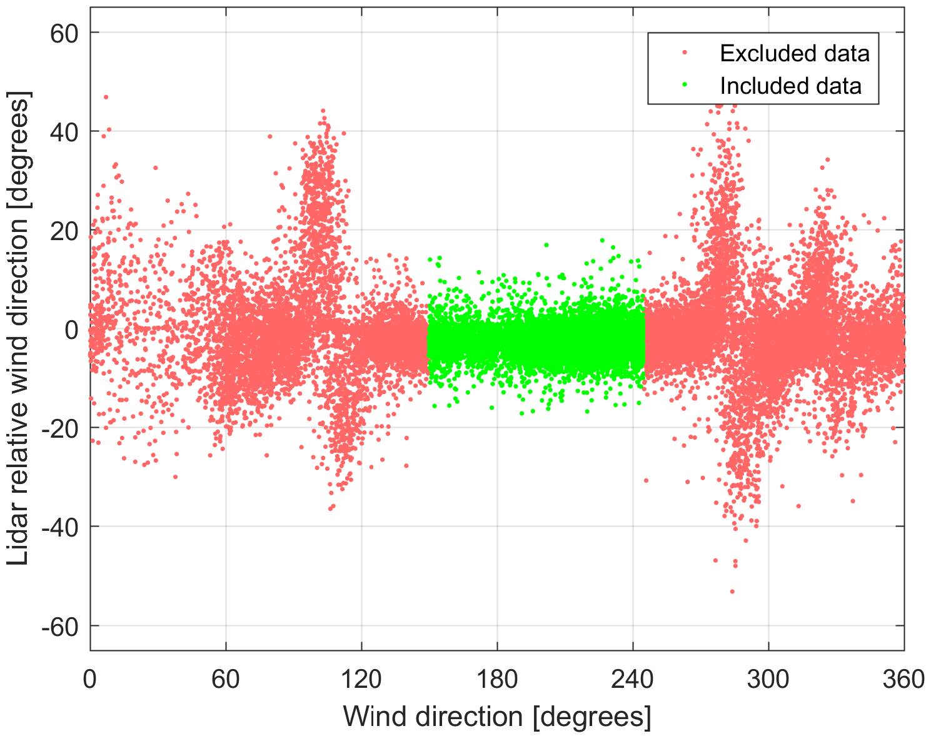
Data filtering
Turbine
Not stopped
Not starting/stopping
Not curtailed
Lidar
RWS0availability and RWS1availability above 0.6
Valid data at >3 ranges
Not in wake

Slide 5
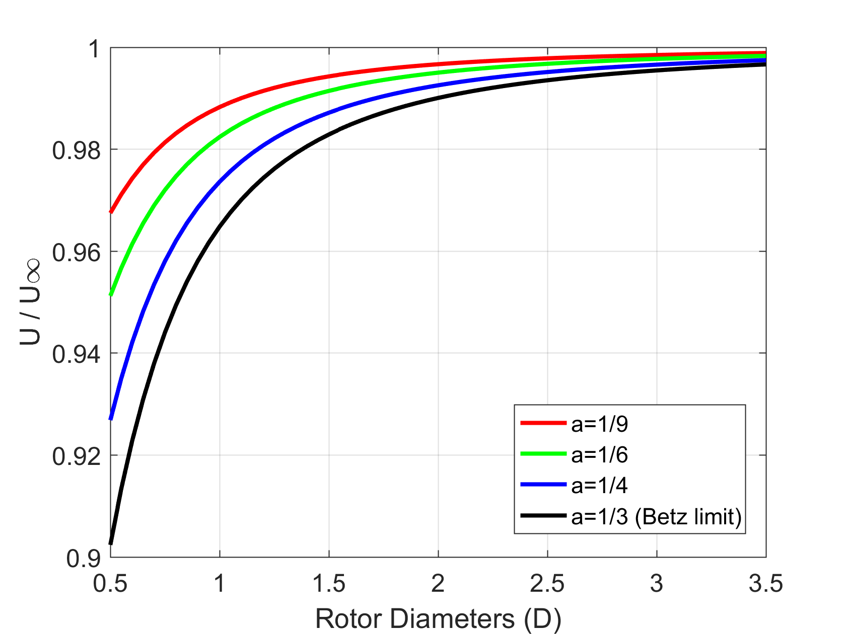
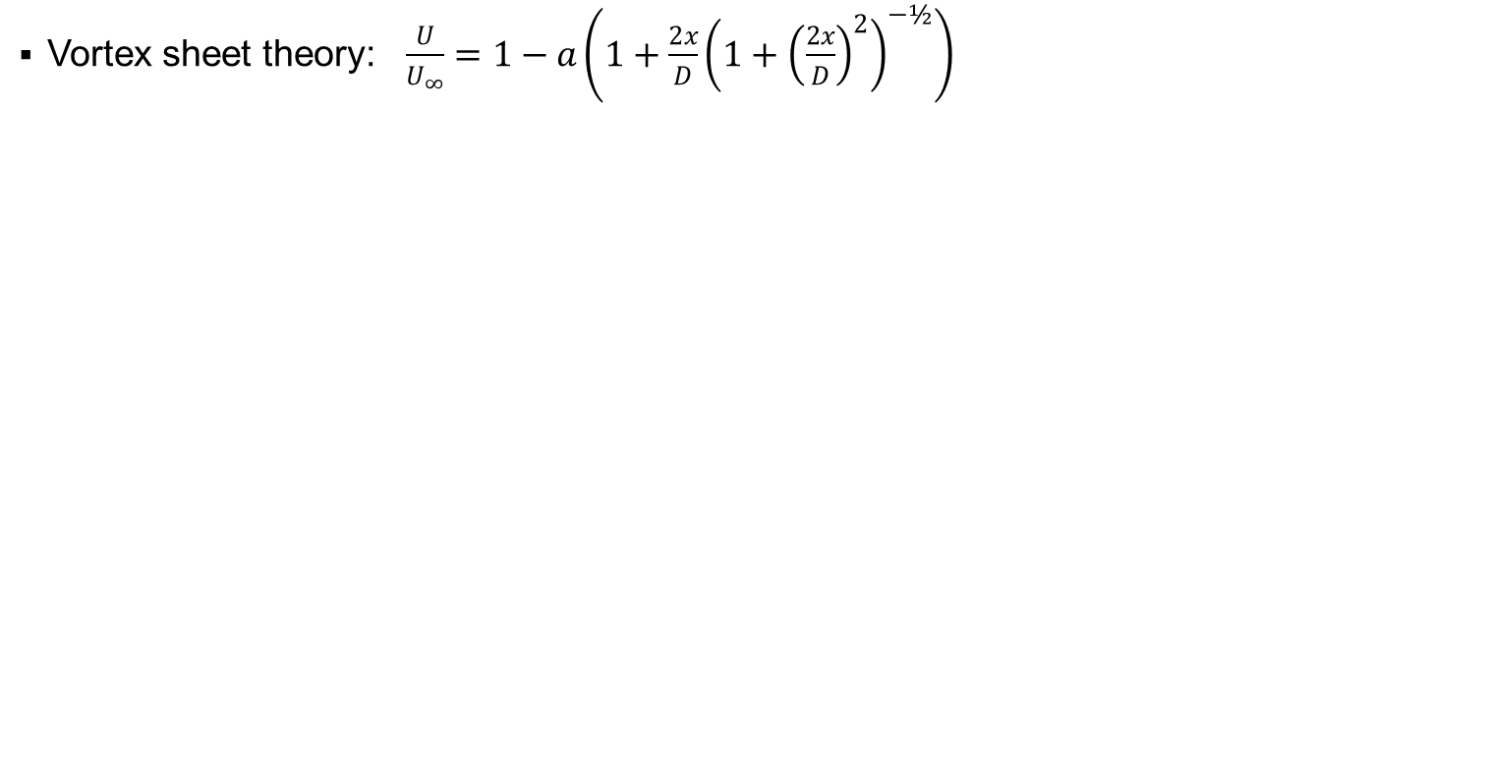
Model of the upstream induction zone
Vortex sheet theory: $\frac{U}{U_{∞}}=1−a\left({1+\frac{2x}{D}\left(1+{\left(\frac{2x}{D}\right)}^{2}\right)}^{−½}\right)$

Slide 6
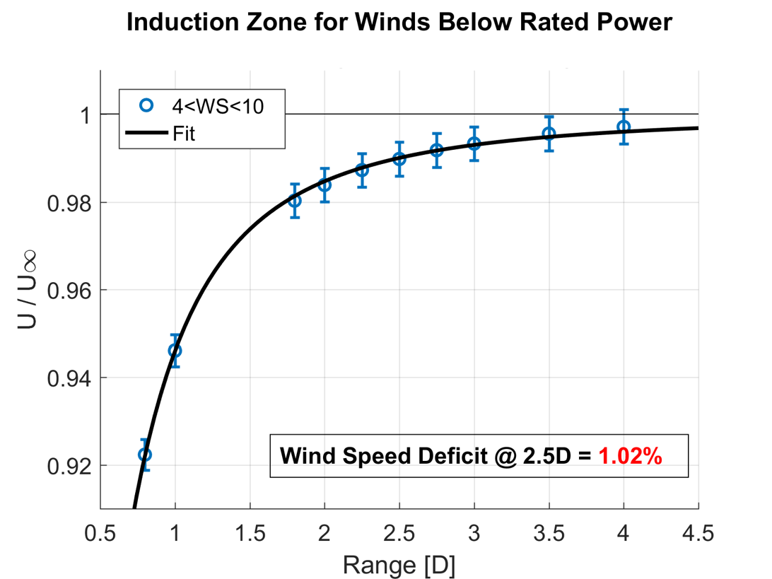
Fit induction model to average wind speed at each range

Slide 7
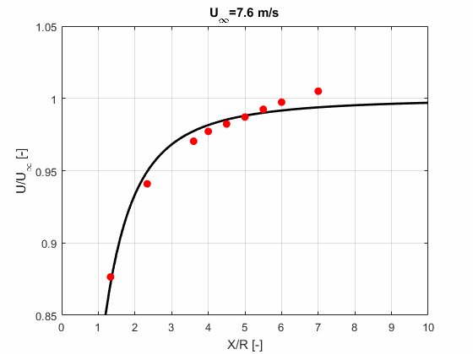
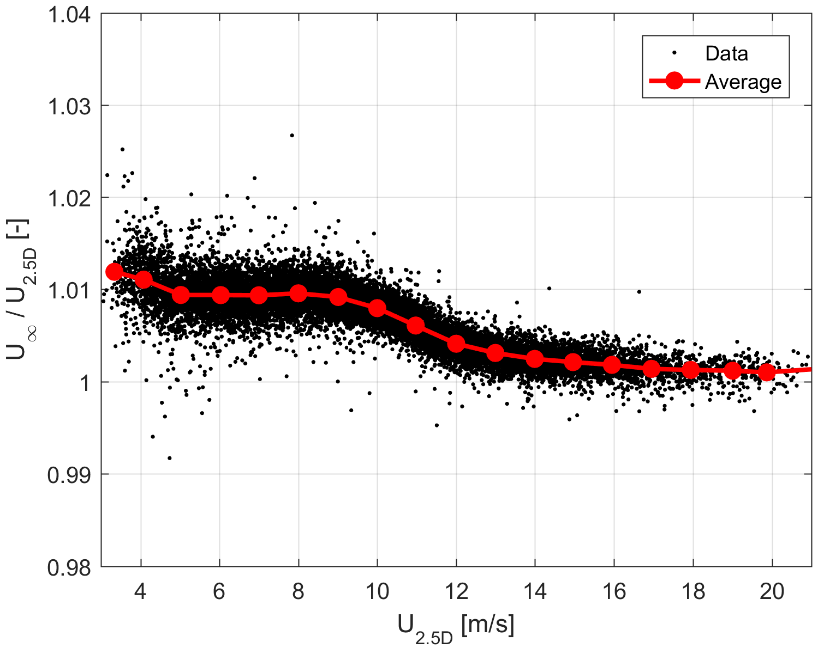
Fit induction model to every single 10 min dataset

Slide 8
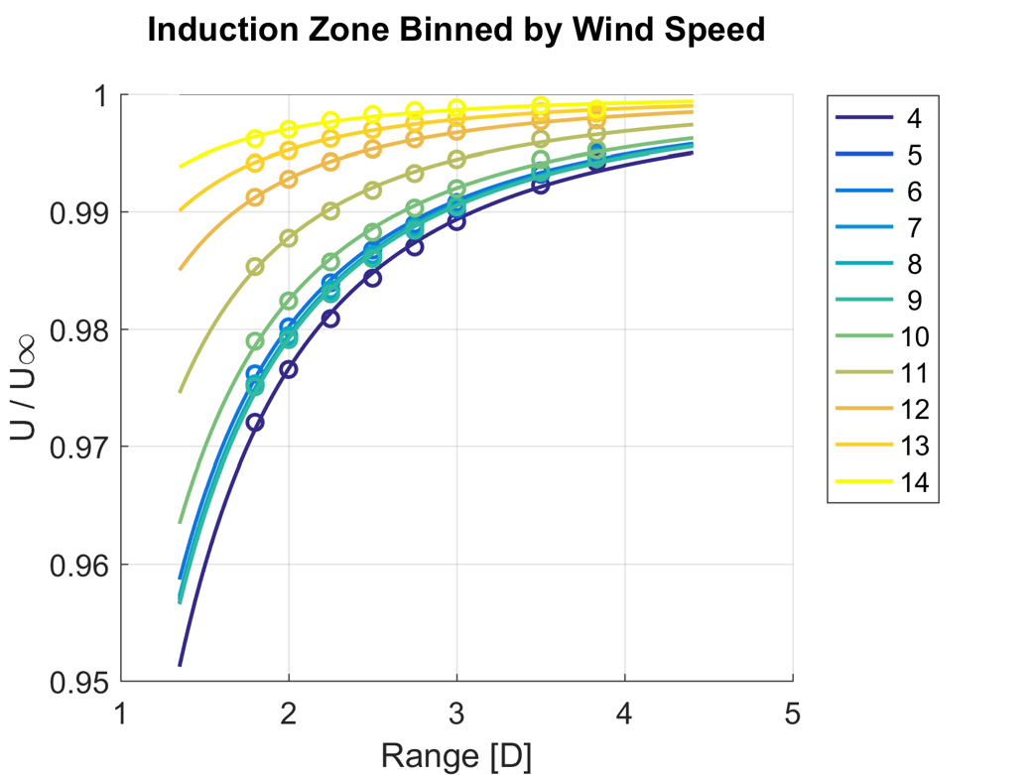
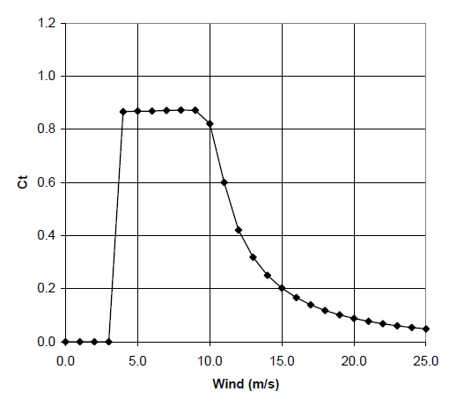
Similar blockage effects for the flat part of the Ct-curve

Slide 9
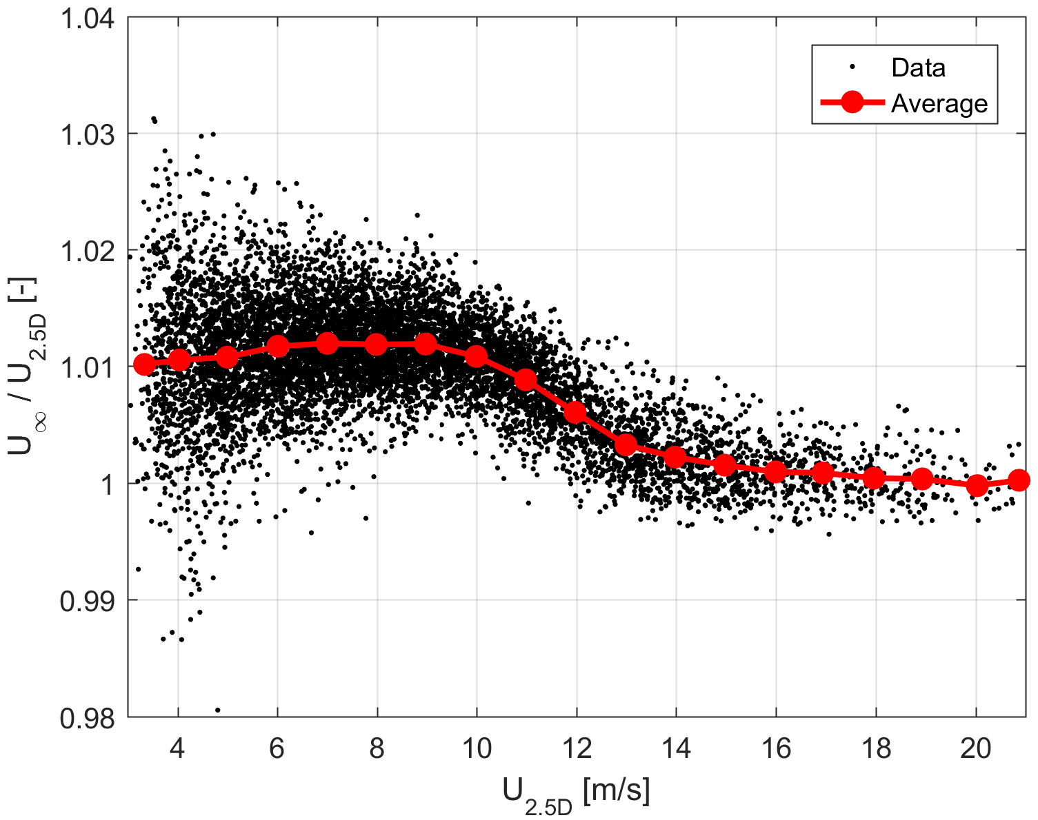
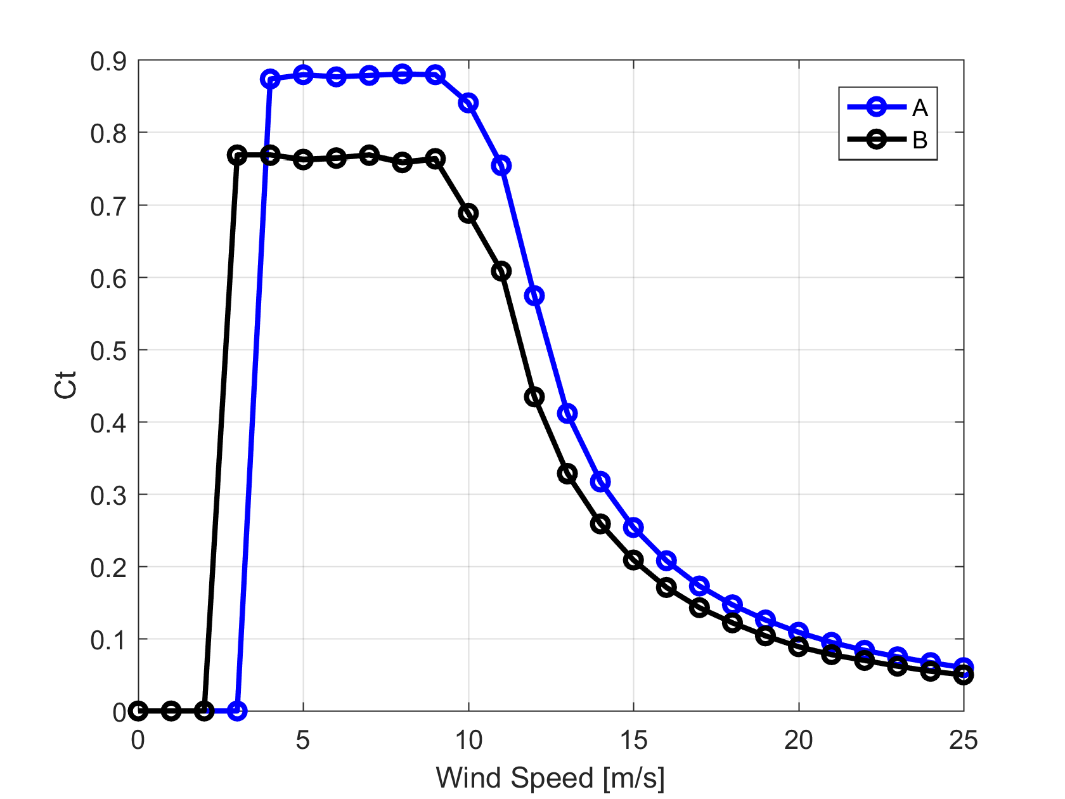
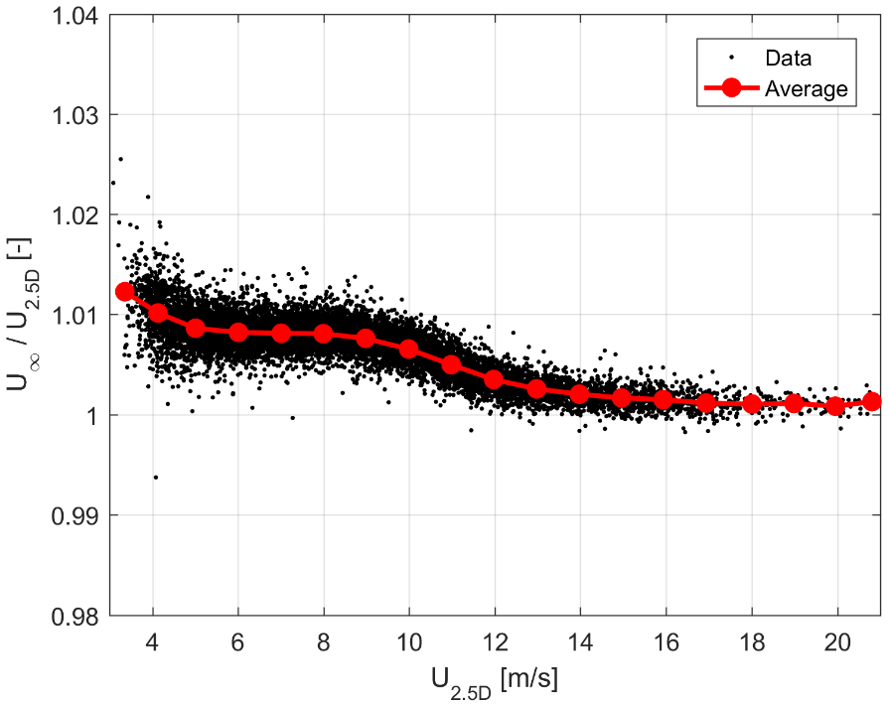
Turbine platform differences

Slide 10
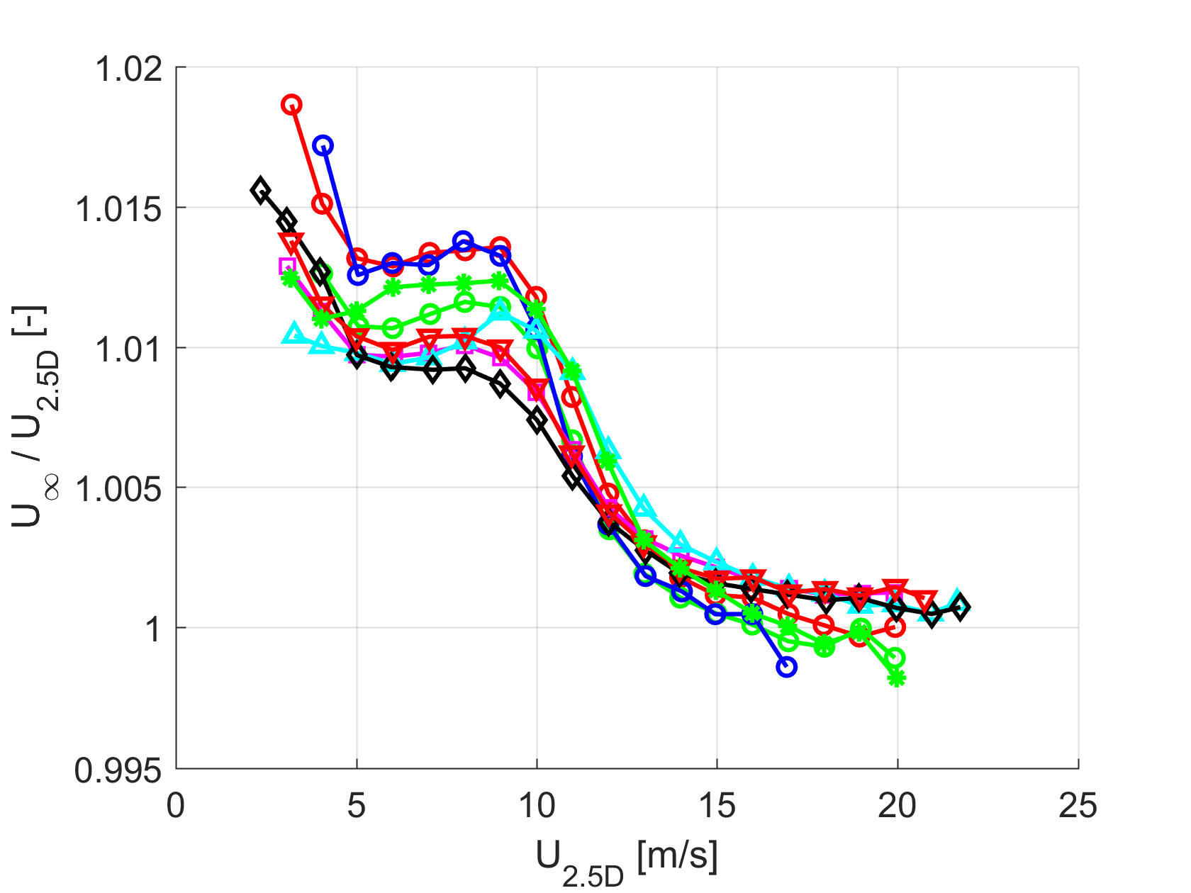
Comparison of measurement campaigns

Slide 11
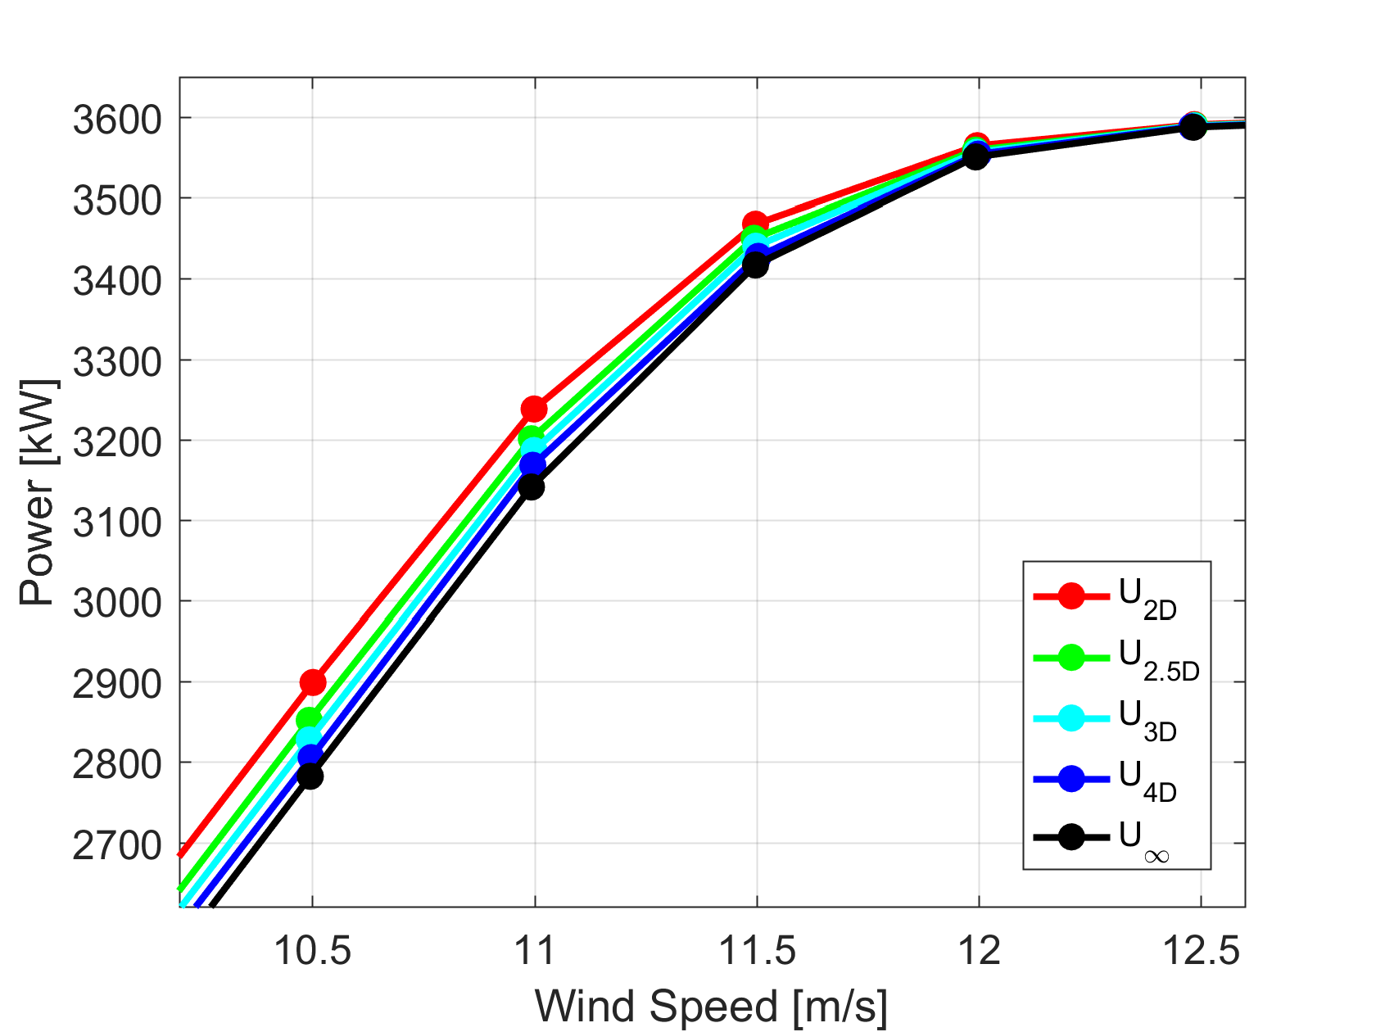
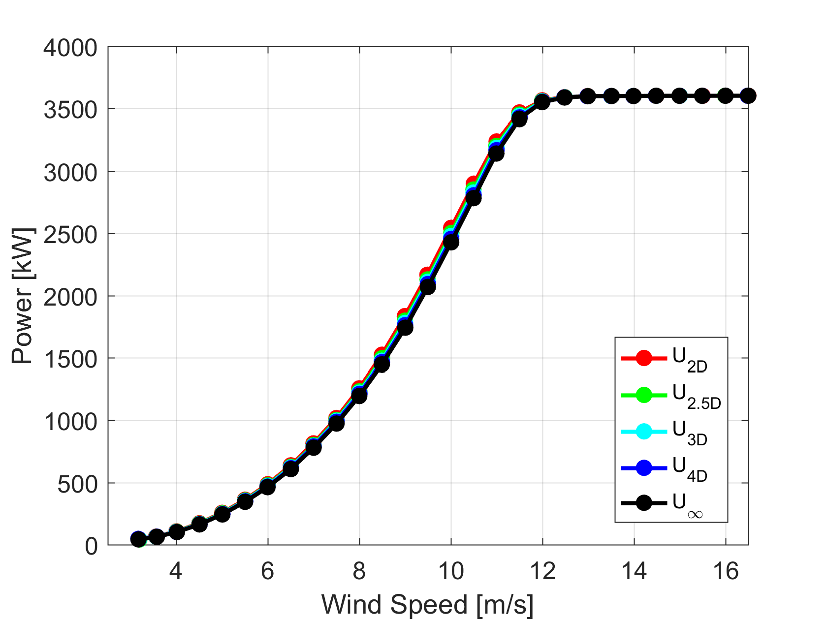
AEP issue #1: Measured power curve at different ranges and at $U_{∞}$

Slide 12
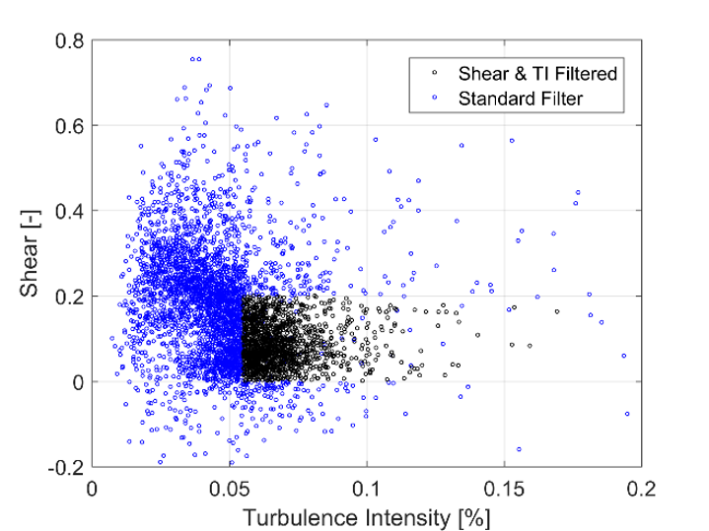
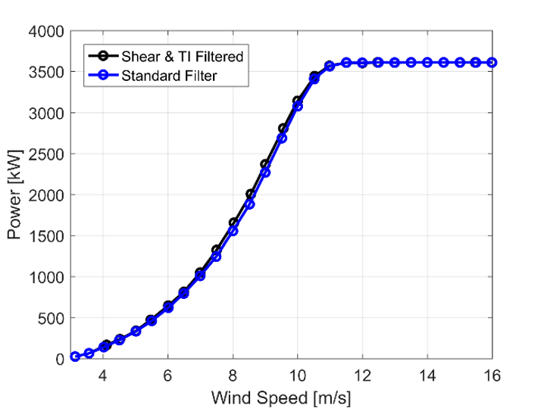
AEP issue #2: Filtering away the real conditions
Low turbulence and in some cases also high shear have a negative impact on the performance

Slide 13
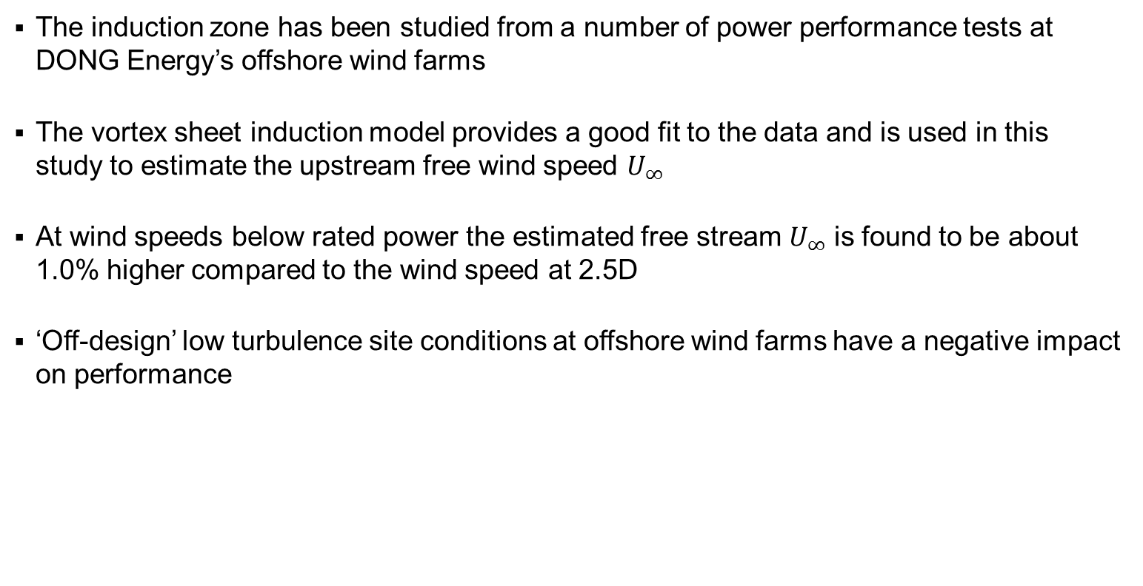
Conclusion
The induction zone has been studied from a number of power performance tests at DONG Energy’s offshore wind farms
The vortex sheet induction model provides a good fit to the data and is used in this study to estimate the upstream free wind speed $U_{∞}$
At wind speeds below rated power the estimated free stream $U_{∞}$ is found to be about 1.0% higher compared to the wind speed at 2.5D
‘Off-design’ low turbulence site conditions at offshore wind farms have a negative impact on performance

Slide 14
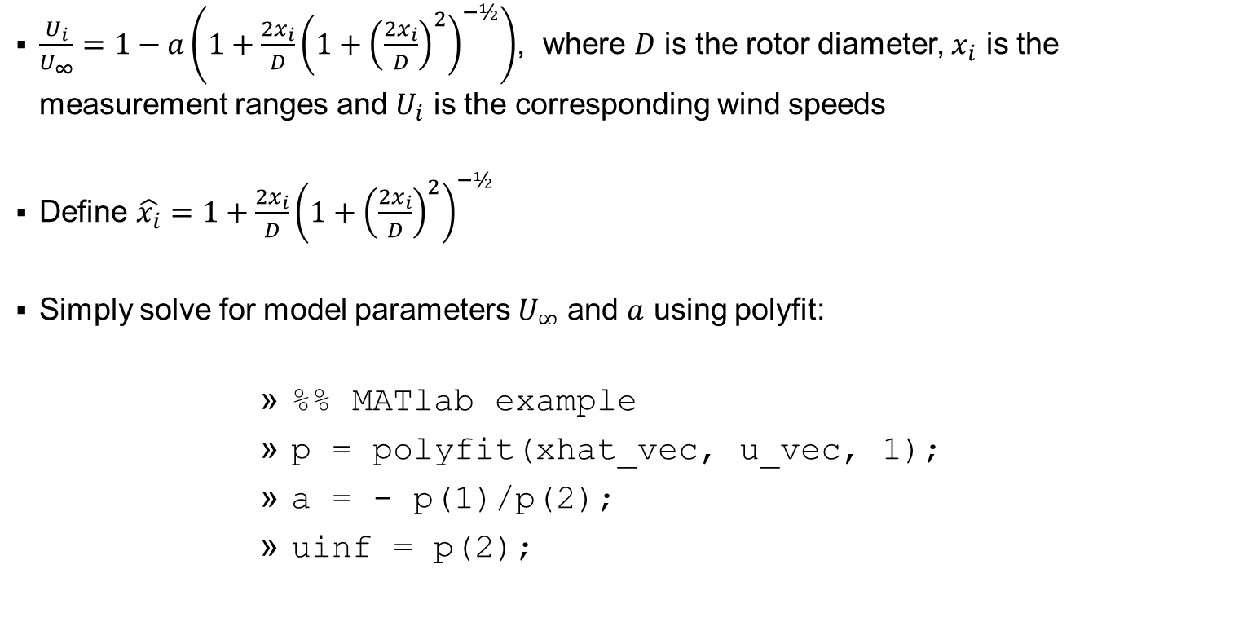
Fitting the induction model to data
$\frac{U_{i}}{U_{∞}}=1−a\left({1+\frac{2x_{i}}{D}\left(1+{\left(\frac{2x_{i}}{D}\right)}^{2}\right)}^{−½}\right)$, where $D$ is the rotor diameter, $x_{i}$ is the measurement ranges and $U_{i}$ is the corresponding wind speeds
Define $\hat{x_{i}}={1+\frac{2x_{i}}{D}\left(1+{\left(\frac{2x_{i}}{D}\right)}^{2}\right)}^{−½}$
Simply solve for model parameters $U_{∞}$ and $a$ using polyfit:
%% MATlab example
p = polyfit(xhat_vec, u_vec, 1);
a = - p(1)/p(2);
uinf = p(2);

